Slide 1

UNIT 1: Who am I?
Gaming

Slide 2
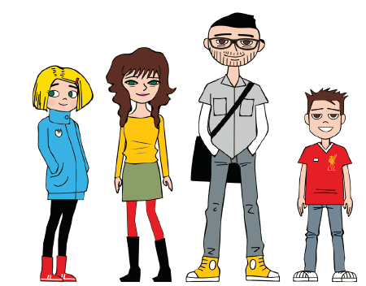
Who are the Browns?

Slide 3
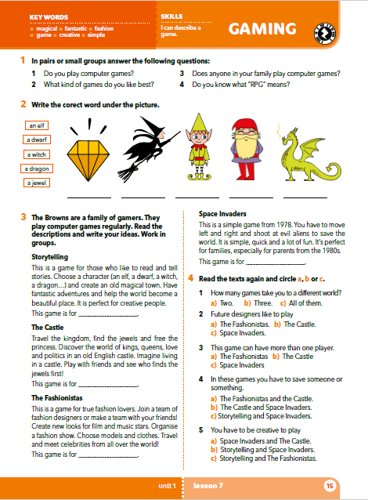
Do you know what ‘’RPG’’ means?
Answer the following questions.
RPG = Role-playing games (Igre uloga)
A game, often an online or computer game, in which players pretend to be imaginary characters who take part in the adventures.
Do you play computer games?
What kind of games do you like best?
Does anyone in your family play computer games?
Do you know what ‘’RPG’’ means?

Slide 4
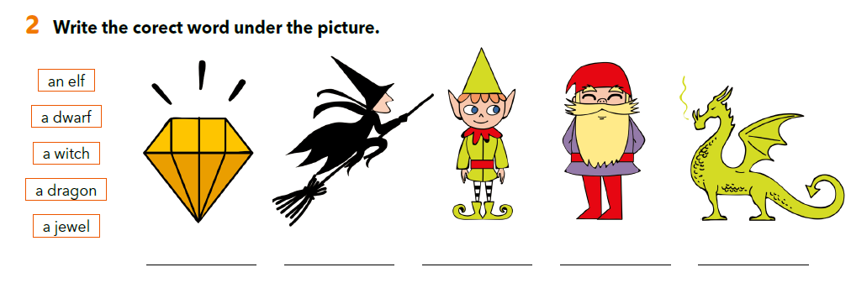
Write the correct word under the correct picture.
a jewel
a witch
an elf
a dwarf
a dragon

Slide 5
an elf - magical -
a dwarf - fantastic -
a witch - fashion -
a dragon - creative -
a jewel - simple -
vilenjak
magičan, čaroban
patuljak
fantastičan
vještica
moda
zmaj
kreativan
dijamant
jednostavan

Slide 6
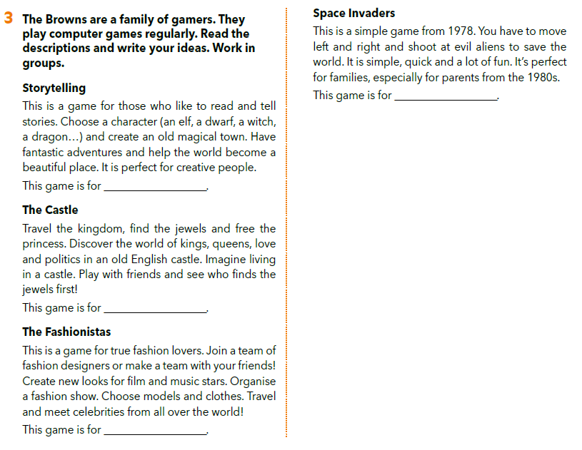
Look at task 3.
The subheads are names of different computer games.
What do you think a character has to do in
Storytelling game?
The Castle game?
The Fashionistas game?
Space Invaders game?
Which of these do you think would Penelope, Anne, Joseph and Noah like?
Do you know any of these games?
Only Space Invaders is an existing game, the rest of them are invented. If you want to know more about the Space Invaders game, you can watch a video on this link: https://youtu.be/kR2fjwr-TzA

Slide 7
What do you think a character has to do in:
Storytelling game?
The Castle game?
The Fashionistas game?
Space Invaders game?
Do you know any of these games?
Space Invaders video:
https://youtu.be/kR2fjwr-TzA

Slide 8
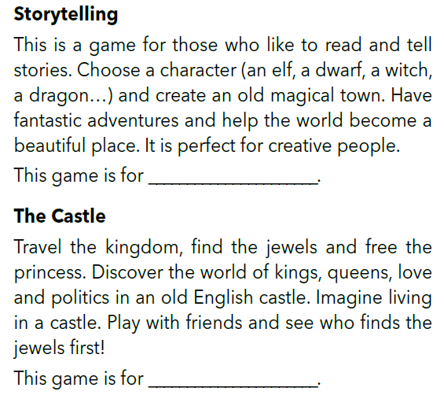
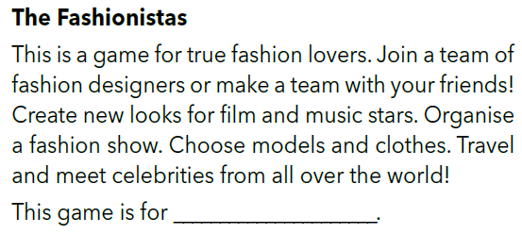
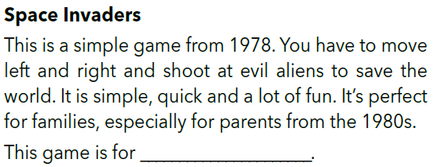
Noah
Penelope
Joseph
Anne
Read the descriptions and write the name of the character on the line.
Underline the sentence(s) in the description which helped you choose the answer.

Slide 9
Read the texts aloud.

Slide 10
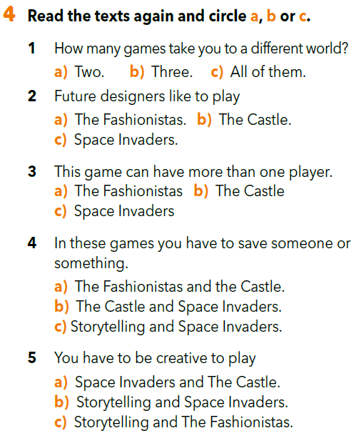
Read the text again and circle the correct answer a, b or c.

Slide 11
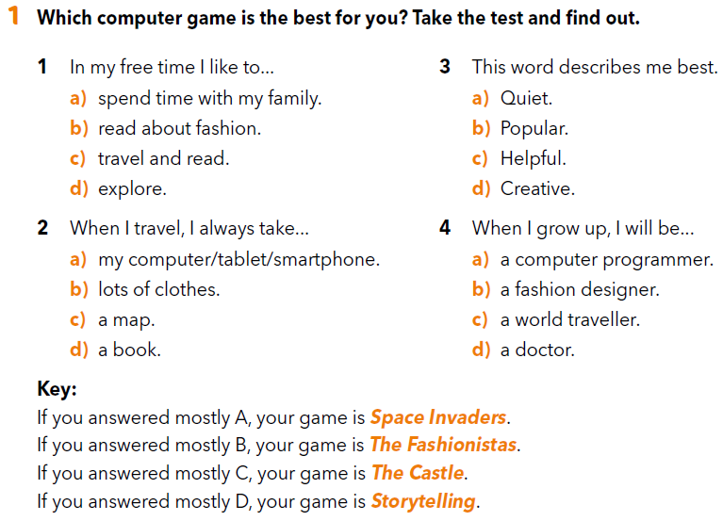
Which of these games is the best for you?
Workbook on page 14.

Slide 12
Do you think it’s true?
Do you like the game the test matches you with?

Slide 13
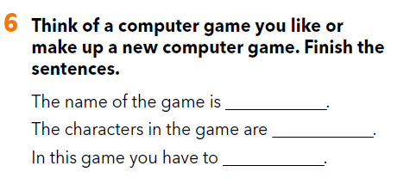
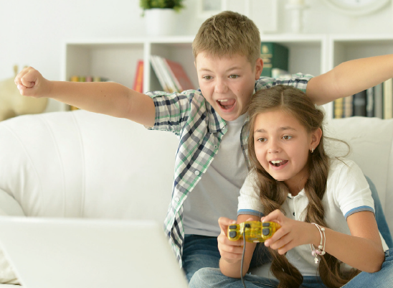
Think of a computer game you like or make up a new computer game. Finish the sentences.

Slide 14
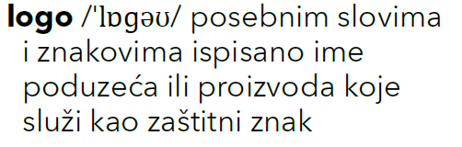
What is a logo?
Create a logo for the game.
Use some paper, colour pencils or, if you want, create it using a computer program such as Paint or Canvas.

Slide 15
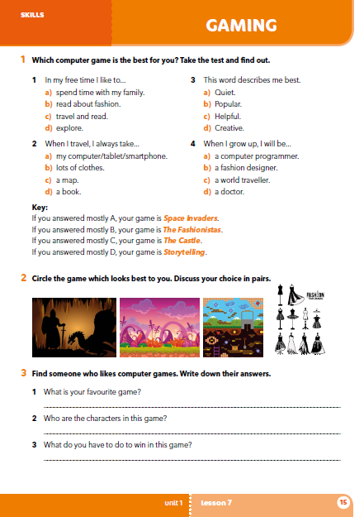
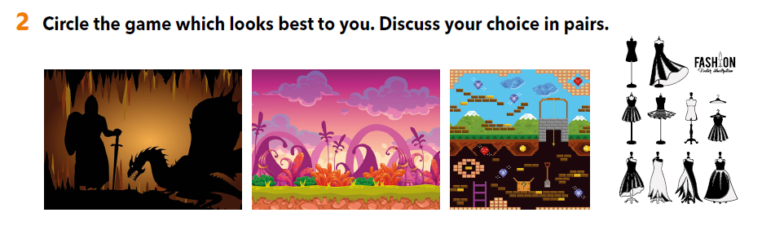
Workbook, page 15.
.
2 – Circle the game which looks best to you. Discuss your choice.

Slide 16
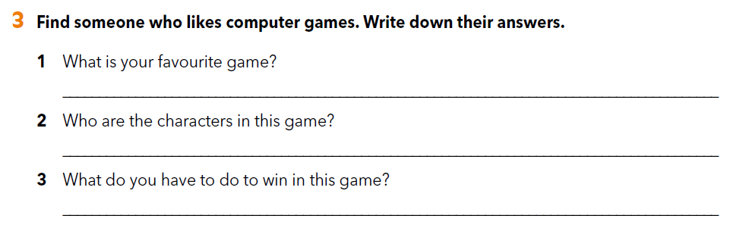
3 - Find someone who likes computer games. Write down their answers.

Slide 17
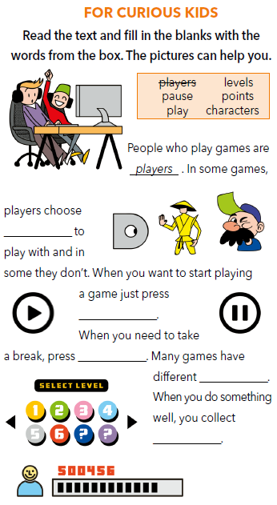
FOR CURIOUS KIDS
Fill in the blanks with the words from the box. The pictures can help you.

Slide 18
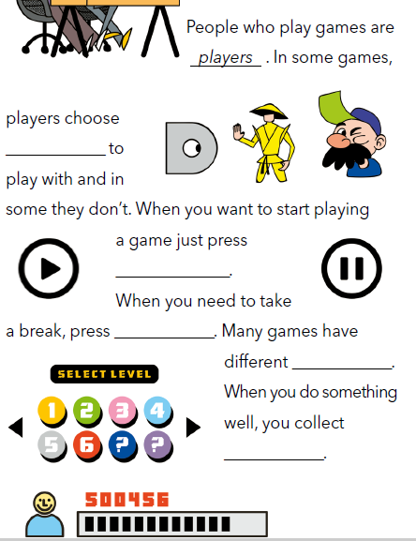
FOR CURIOUS KIDS
characters
play
pause
levels
points

Slide 19
Let’s practise!
Read the texts and answer the questions.
https://www.e-sfera.hr/dodatni-digitalni-sadrzaji/c7b6f291-b13b-43c7-a309-ce394b0dbfa4/

